Slide 1
Machine Learning with Raspberry Pi
Speech Synthesis
AI Code Academy

Slide 2
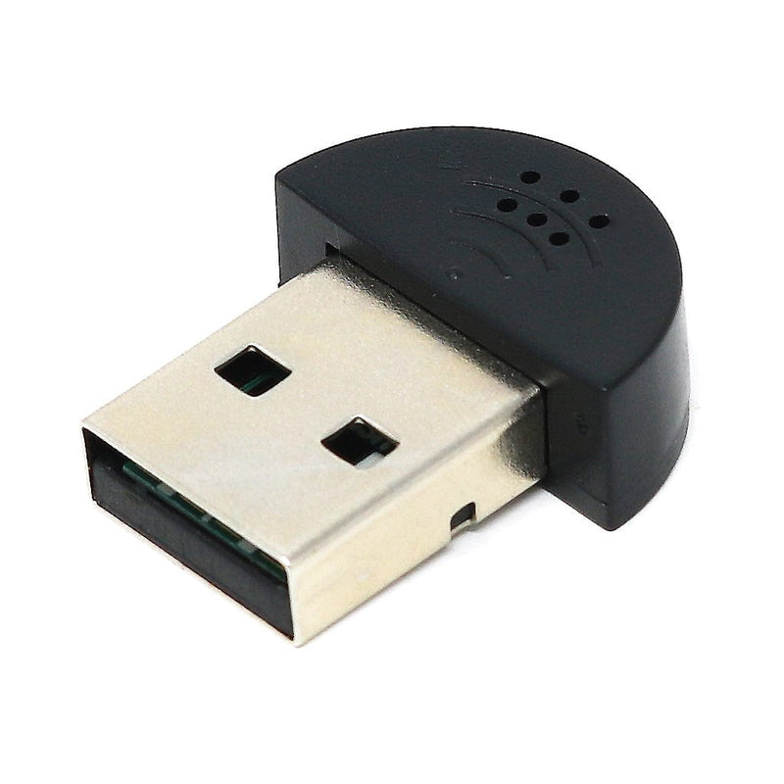
Materials Needed
For this lesson, we’ll need the following materials:
Raspberry Pi with SSH and VNC connection
USB Speaker
USB Microphone
LED
220 Ohm Resistor

Slide 3

Speech Synthesis
Speech synthesis is the process of converting a text input into spoken words.
Speech synthesis will use a machine learning model to determine how the words should be said depending on factors like speed, gender, and more.
Have you ever used a device that had speech synthesis?

Slide 4
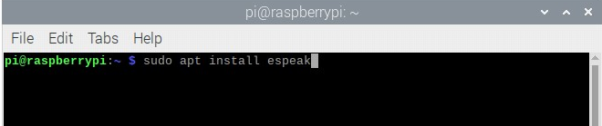
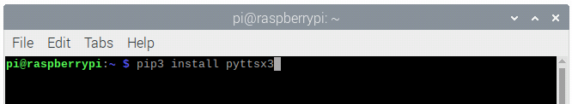
Package Installation
For our project we will use espeak to synthesize our text.
The pyttsx3 module allows us to use espeak in python.
Please run the following commands to install the necessary packages.
sudo apt install espeak
pip3 install pyttsx3

Slide 5
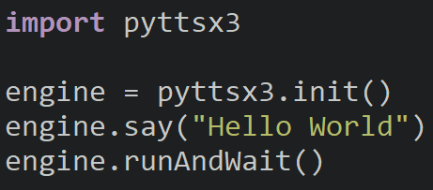
Speech Test
To use the speech synthesizer, we must initialize it and save a reference to it.
Whenever you want it to speak, call the say function followed by runAndWait.
Run it and hear it speak.

Slide 6
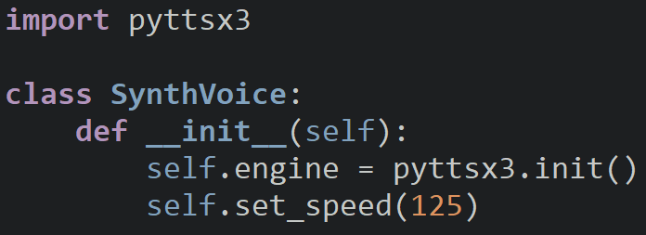
synth_speech_utils.py
We are going to create a class to store the model to simplify the use of speech synthesis in future projects.

Slide 7
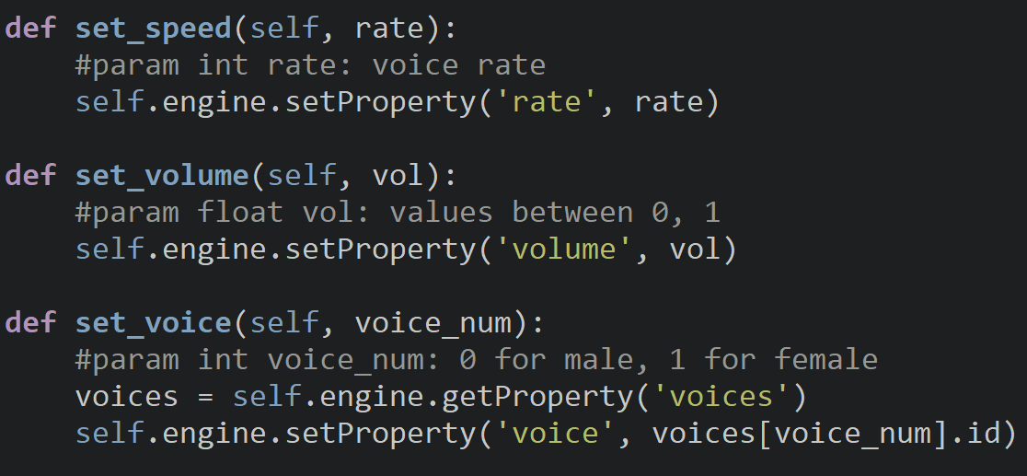
synth_speech_utils.py
Each of the following methods will set different properties for the speech synthesizer like the rate it speaks at, the volume, and the gender of the voice.

Slide 8
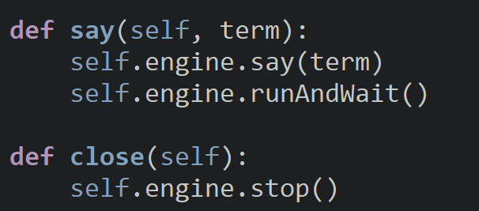
synth_speech_utils.py
The say and close methods contain the code to say a word and to close the synthesizer.

Slide 9
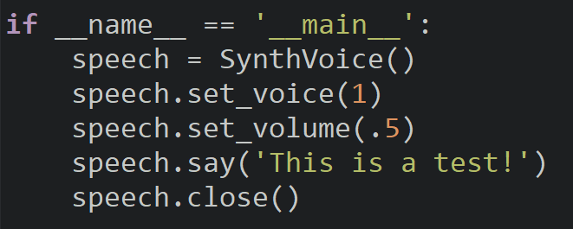
synth_speech_utils.py
The program entrance will create our SynthVoice and set it to a female voice at half volume and to speak.

Slide 10
Final Project
Our final project for this class will be to create our very own AI assistant that we can talk to and have talk to us.
Today we will add the basics for it so it can recognize us saying its name and then next class we will add features for it.
Please open the template and go to AICODE101 and we will begin working on our AI assistant.

Slide 11
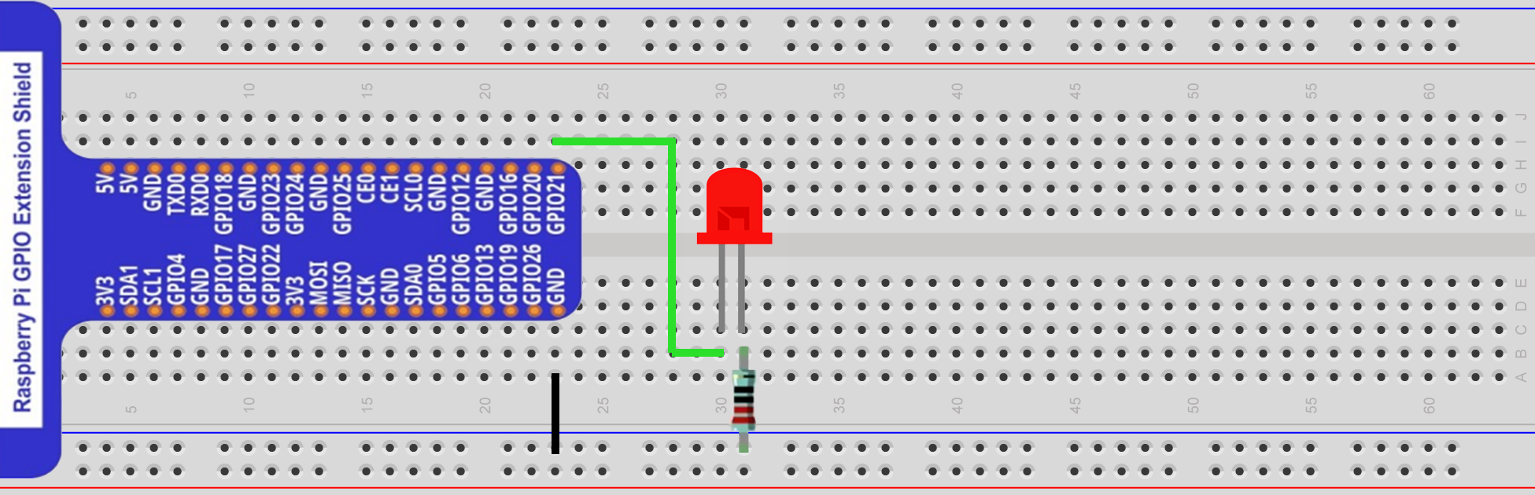
Circuit
We will have an LED turn on if we have the assistant listening to us and we will turn it off when it is done listening.
Feel free to change the GPIO pin, I will be using GPIO 21.

Slide 12
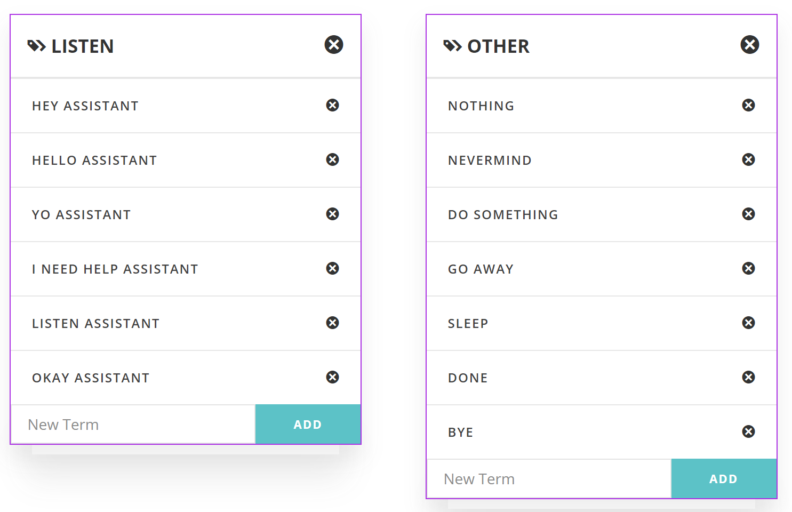
Machine Learning Model
We will begin working on the model for our AI and add one category for a command that gets the assistant’s attention. Some common phrases are “okay”, “hey”, “hello” followed by the assistant’s name.
Create another category with other words in it that are not attention grabbing like telling it to go and so on.
Grab your model ID and we will supply it to the assistant.

Slide 13
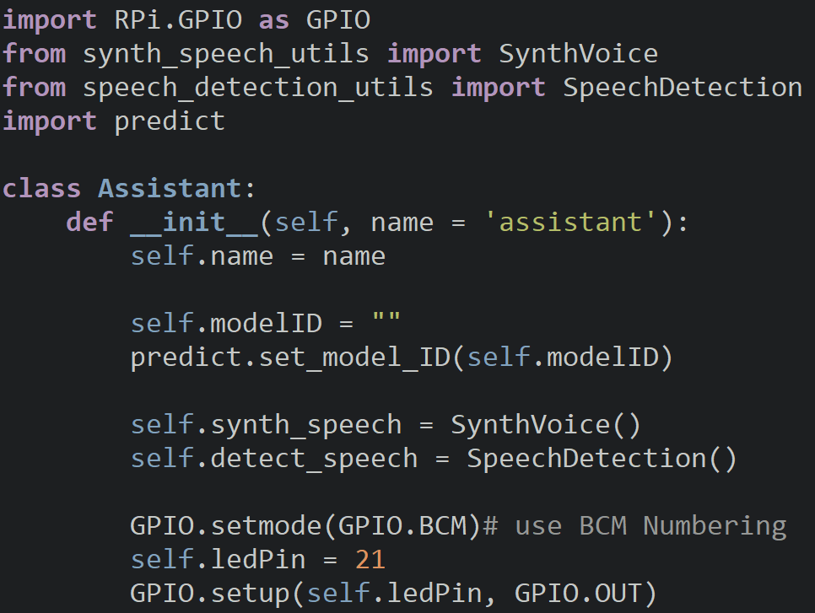
Assistant
We will first import all the necessary modules for the program and create the class and constructor.
Inside the constructor we will create variables and initialize our speech synthesizer and detector, configure the ML model, and setup our LED.
Don’t forget to replace the model ID.

Slide 14
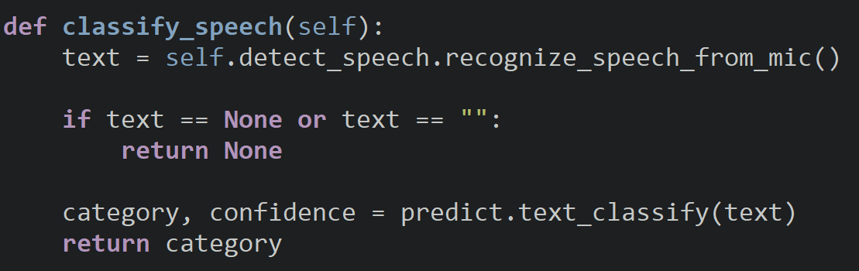
Classify Speech
The classify speech method will detect speech from the microphone and ensure it is of a proper type before predicting what command it is. It will then return the command (category).

Slide 15
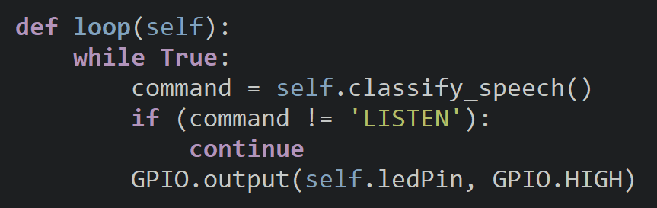
Loop
The loop function will work in two parts, first part is for the AI to wait for it to be needed and then to act on a command we give it.
We will classify our speech and if our command is not to listen to it, we will restart the loop. If we want the assistant to listen to us, we will turn on the LED.

Slide 16
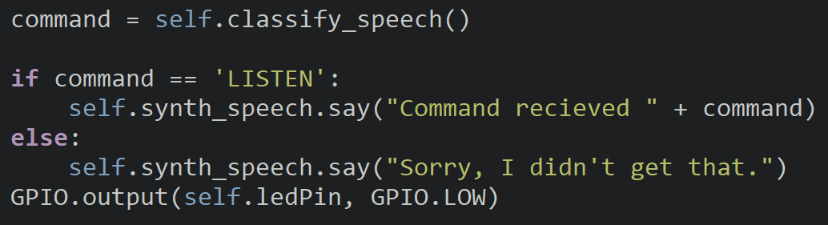
Loop
If the previous command was to listen, listen and check what command is.
For now, we will check for LISTEN again and have it repeat the command. You will add more commands later.
If the command is anything else, the AI will say it didn’t understand. We will turn off the LED at the end of the function.

Slide 17
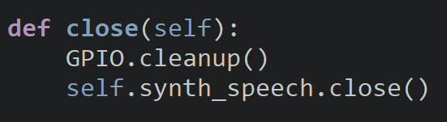
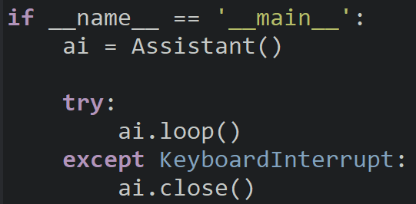
Close & Program Entrance
The close method will act as our destroy and we will cleanup the GPIO pins and close the speech synthesis.
In the program entrance, we will create the ai and run the loop. If we use the keyboard interrupt, we will call the close method.

Slide 18
Try It Out
Did you AI respond to you when you spoke?
Did it notice you call its name?
Did it activate when you said something other than its name?
How can we improve our assistant?

Slide 19
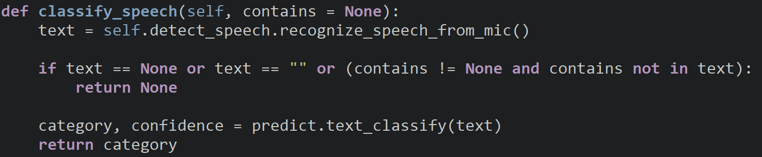
Classify Speech
Modify the classify speech method to add a parameter to check if the text returned contains a keyword. We will use the assistant’s name as a keyword.
By default, the keyword will be None and if the keyword isn’t None and isn’t in the text, we will return None.

Slide 20
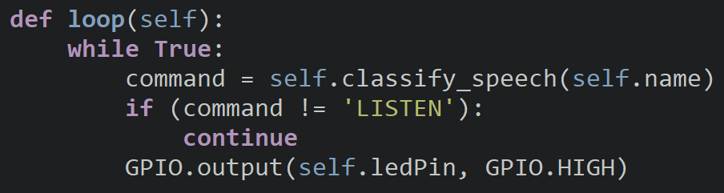
Loop
We will modify the loop so it will use the AI’s name as a keyword when we check if it is listening.

Slide 21
Discussion
Did your AI respond to you when you called its name?
What other uses are there for speech synthesis?
What features are you going to add to your AI assistant?

Slide 22
Power off
As usual, shut down your pi properly before disconnecting power.

